Slide 1


PizzaZone
Presented By-
Abhishek Shetty(229003)
Chinmay Vyawahare(229113)
http://www.free-powerpoint-templates-design.com

Slide 2

Points to be discussed
Screenshots
Specification
Conclusion
Introduction
Motivation
Disadvantages
Future Enhancement
References
Advantages
S/W and H/W
Requirement
Objectives
UML Diagrams

Slide 3
Introduction
A Pizza Ordering System is a web-based platform designed to simplify and streamline the process of ordering pizza. This system provides users with a user-friendly interface to place their orders online, customize their pizzas according to their preferences, and track their delivery status in real-time. The system also allows users to save their order history and payment details for easy reordering in the future. With the Pizza Ordering System, customers can enjoy a seamless and hassle-free ordering experience, making it the go-to platform for pizza lovers everywhere.

Slide 4
Motivation
In today's fast-paced world, people have a limited amount of time to spare, and they want to make the most out of it. Ordering pizza is one of the most popular ways of enjoying a quick and delicious meal, but traditional ordering methods can be quite time-consuming.
By introducing an online pizza ordering system, customers can now conveniently place their orders from anywhere at any time, without the need to physically visit the restaurant. This saves valuable time and effort for both the customers and the restaurant staff.
Furthermore, the online pizza ordering system can provide customers with a wide range of options to choose from, including various toppings, crust types, and sizes, allowing them to customize their pizza according to their preferences.
In addition, an online pizza ordering system can provide customers with an easy and secure payment gateway, eliminating the need for cash transactions and making the process more convenient and reliable.

Slide 5
Objectives
The main objective of the pizza ordering system is to provide customers with a hassle-free and efficient way to order their favorite pizza online. The system's objective is to minimize the time and effort required by customers to place their orders by offering a seamless ordering process that is accessible from anywhere at any time. This allows customers to easily browse through the menu, select their desired items, and customize their orders according to their preferences.
Another objective of the pizza ordering system is to provide customers with a secure and reliable payment gateway, ensuring the confidentiality of their personal and financial information. This helps to build trust and confidence among customers, resulting in higher customer satisfaction and loyalty.
Furthermore, the pizza ordering system aims to streamline the operations of the restaurant by automating the entire ordering process, reducing wait times, and minimizing order errors. This results in improved efficiency, increased productivity, and higher profits for the restaurant.

Slide 6
Technology Used:
Front End: Angular
Back End: Java Spring Boot API.

Slide 7
UML Diagrams

Slide 8
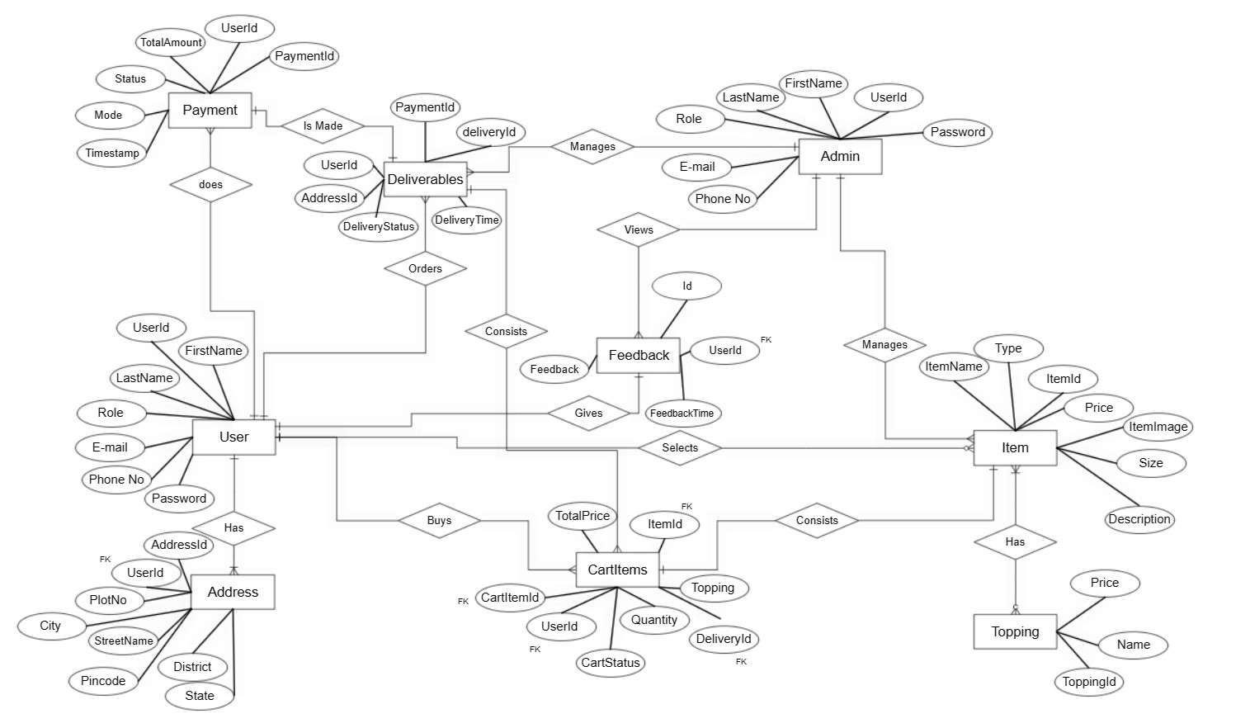
E-R Diagram

Slide 9
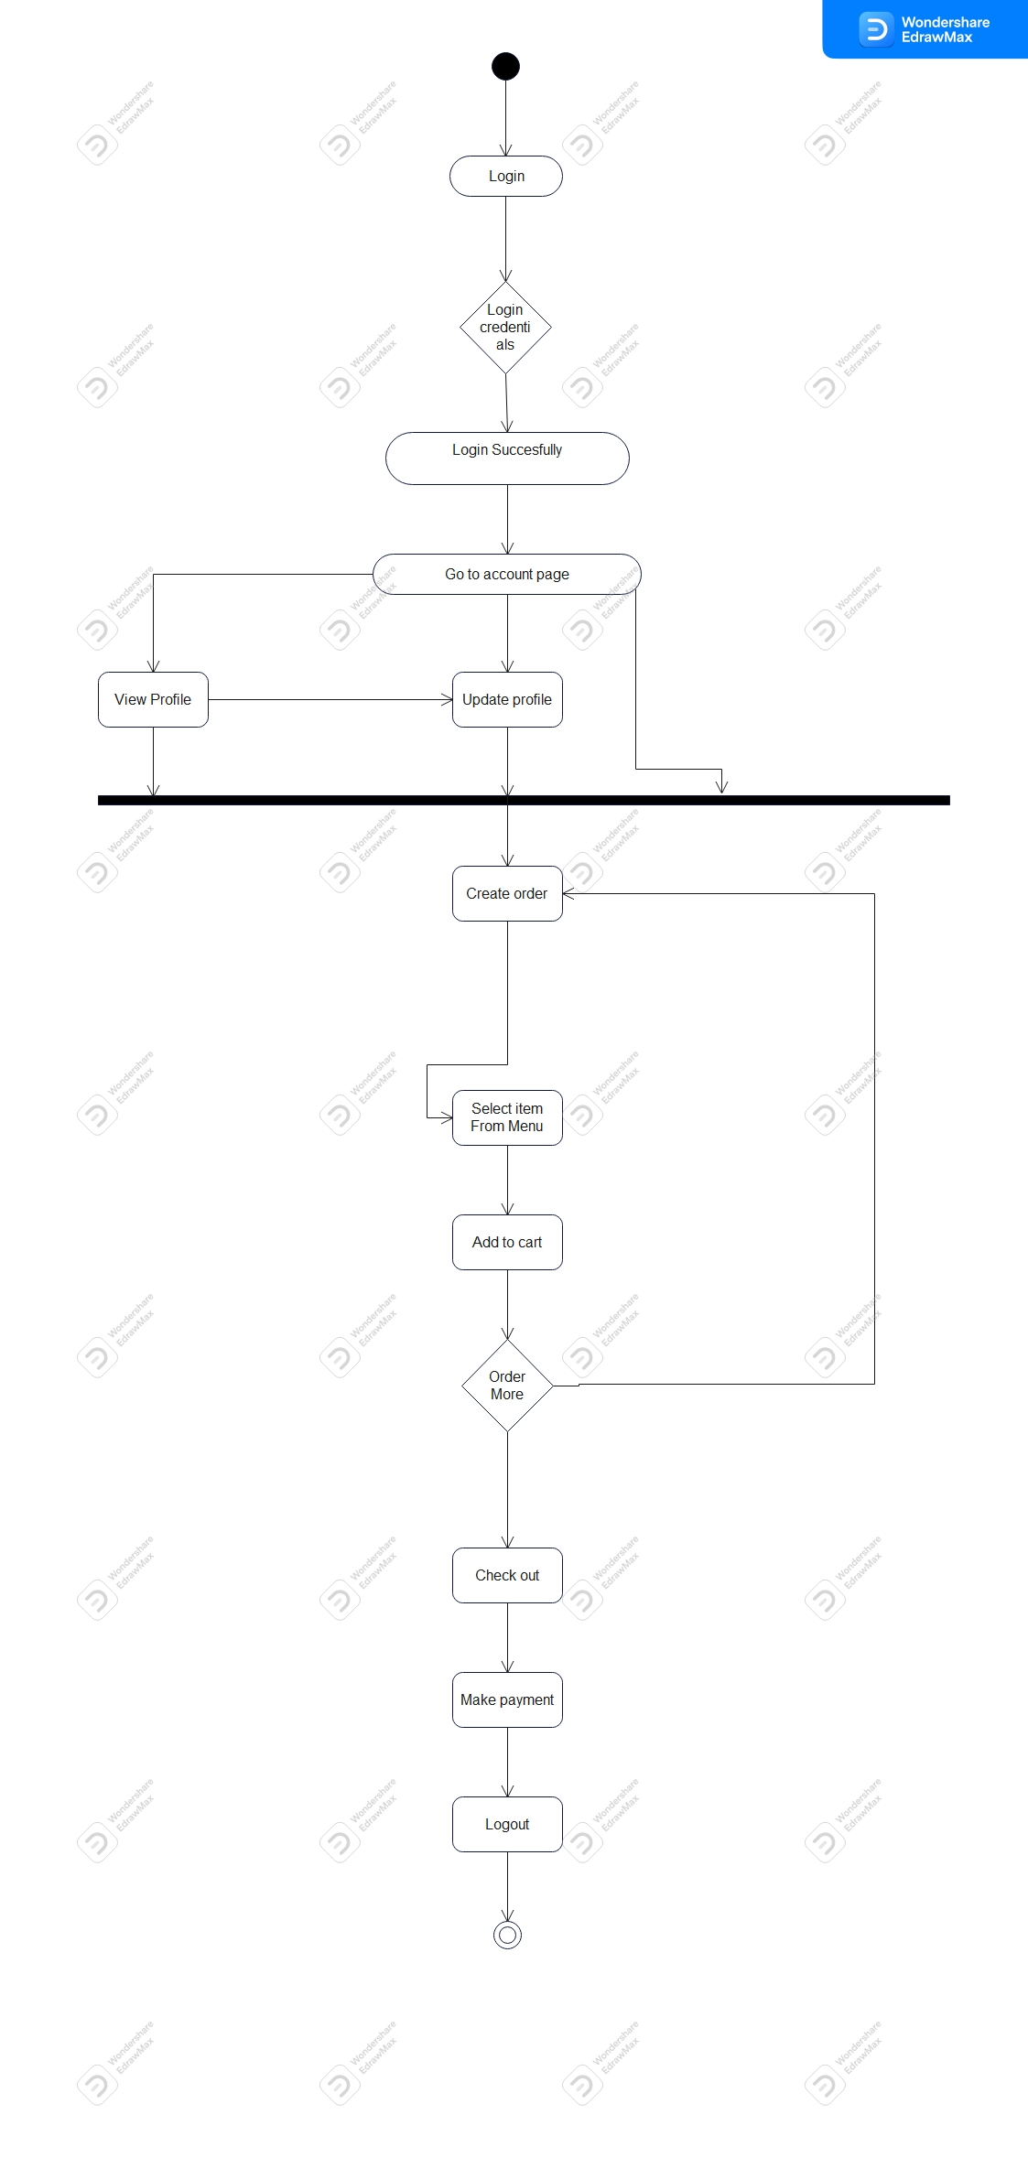
Activity Diagram Of User

Slide 10
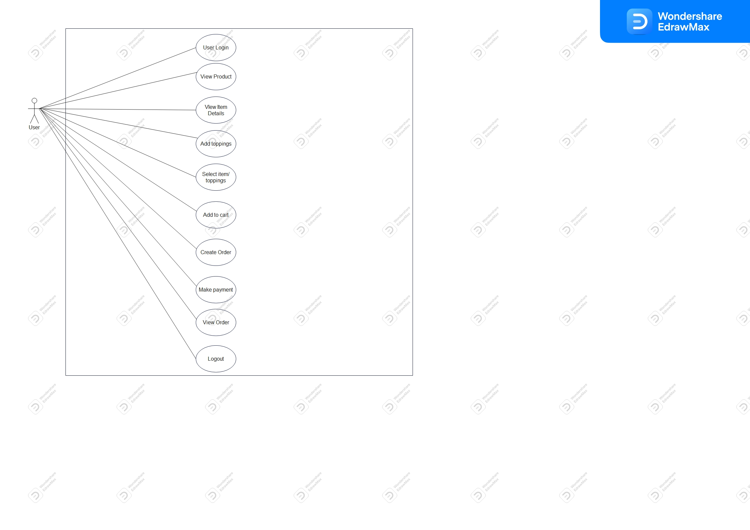
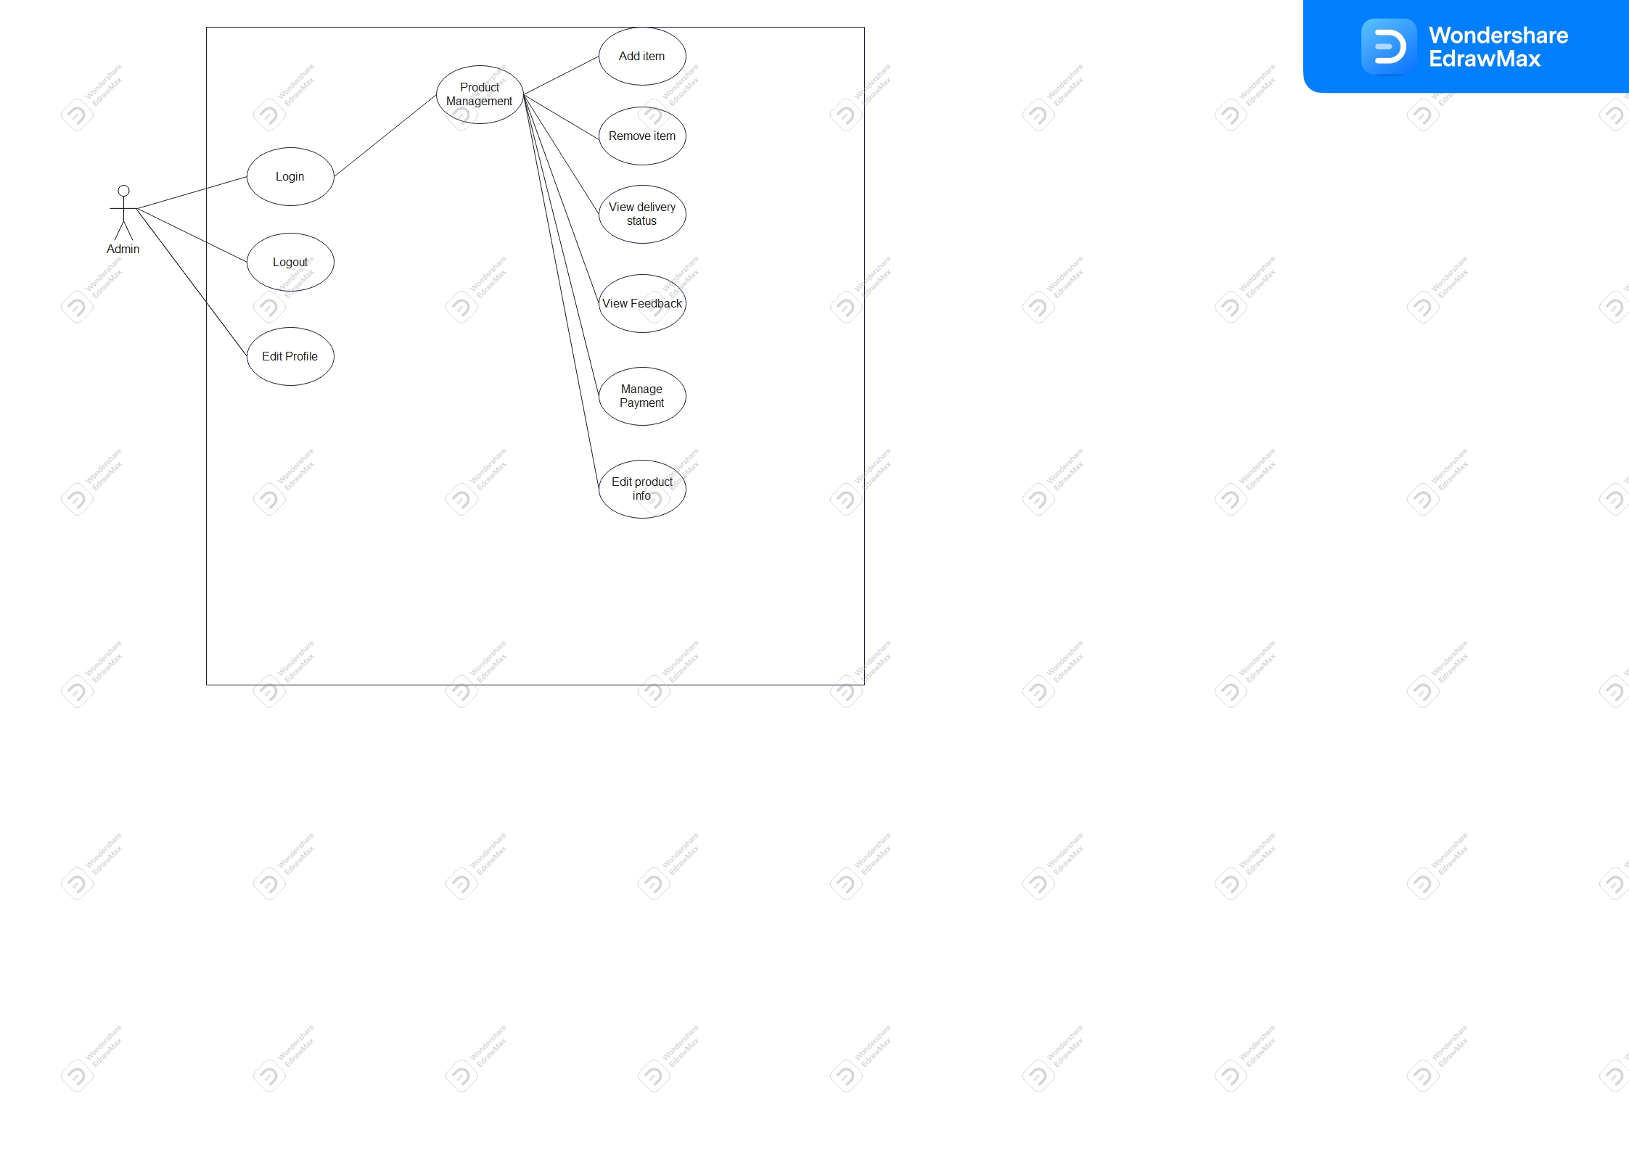
User
UseCase Diagram
Admin UseCase
Diagram

Slide 11
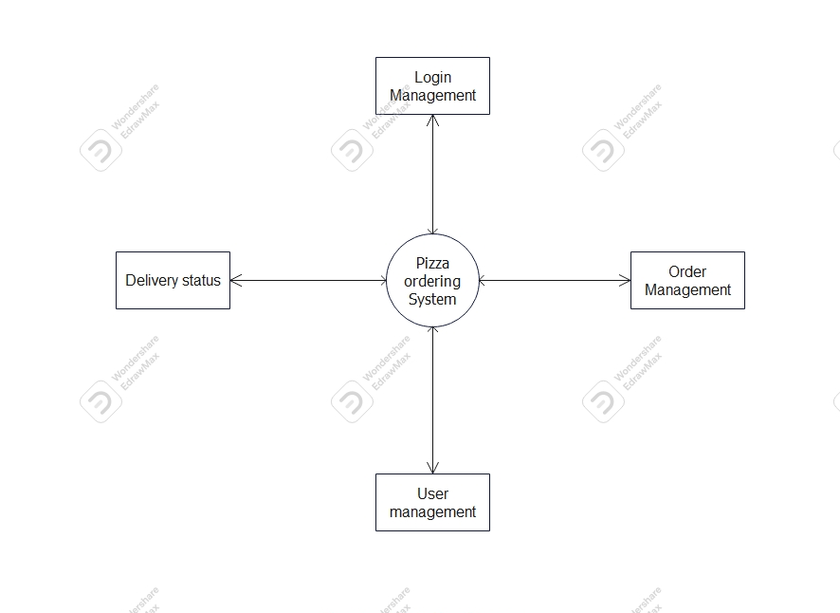
DFD Diagram

Slide 12

1st level data flow diagram

Slide 13
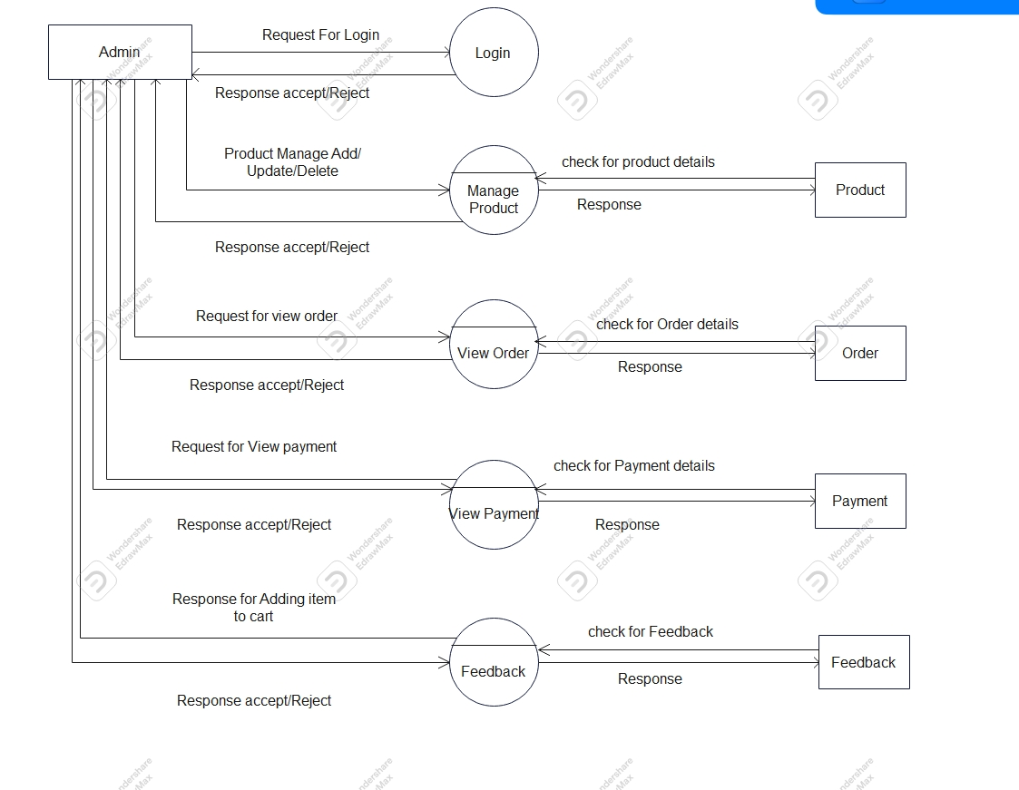
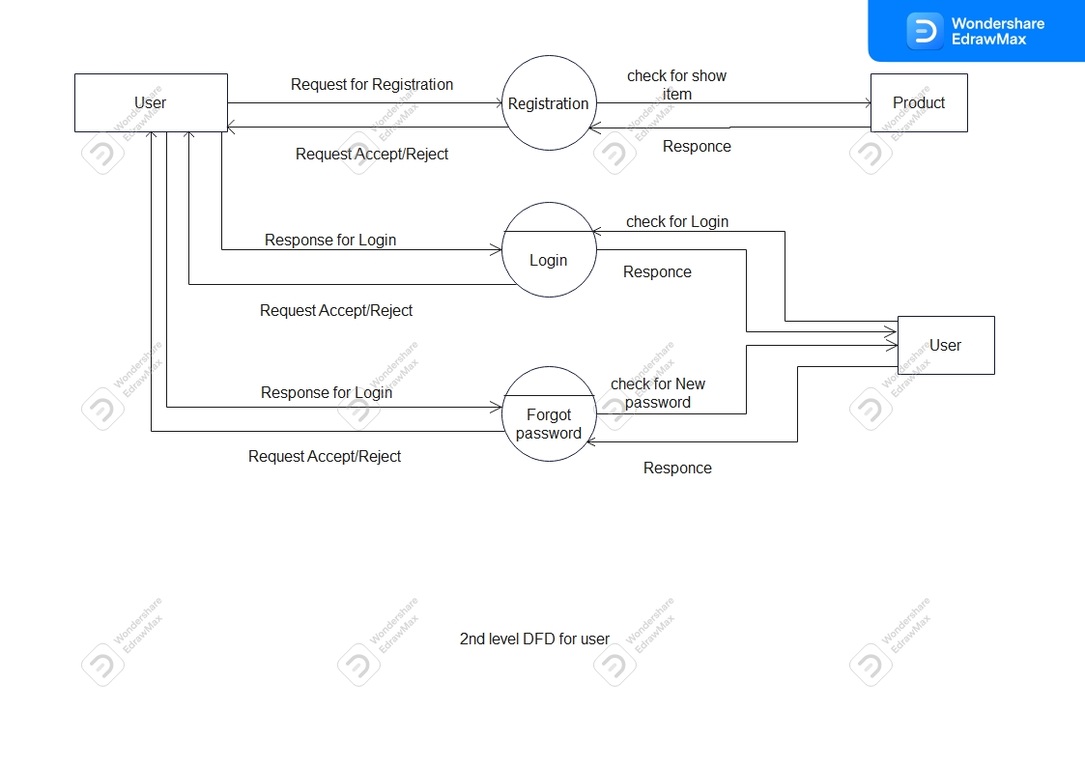
Admin Side DFD
User Side DFD

Slide 14
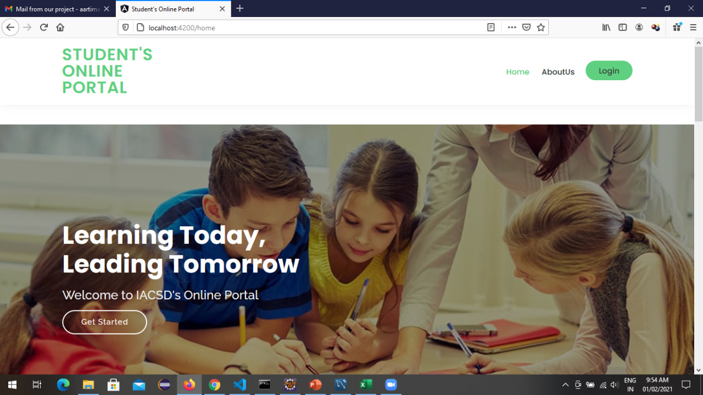

Slide 15
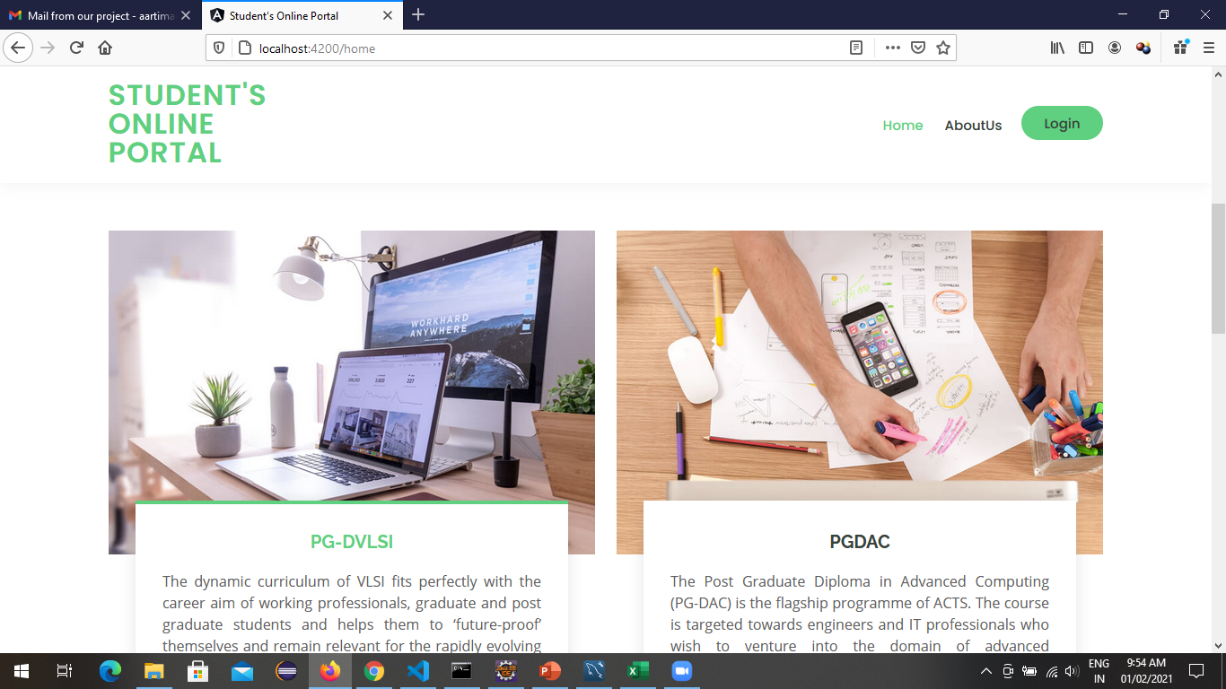
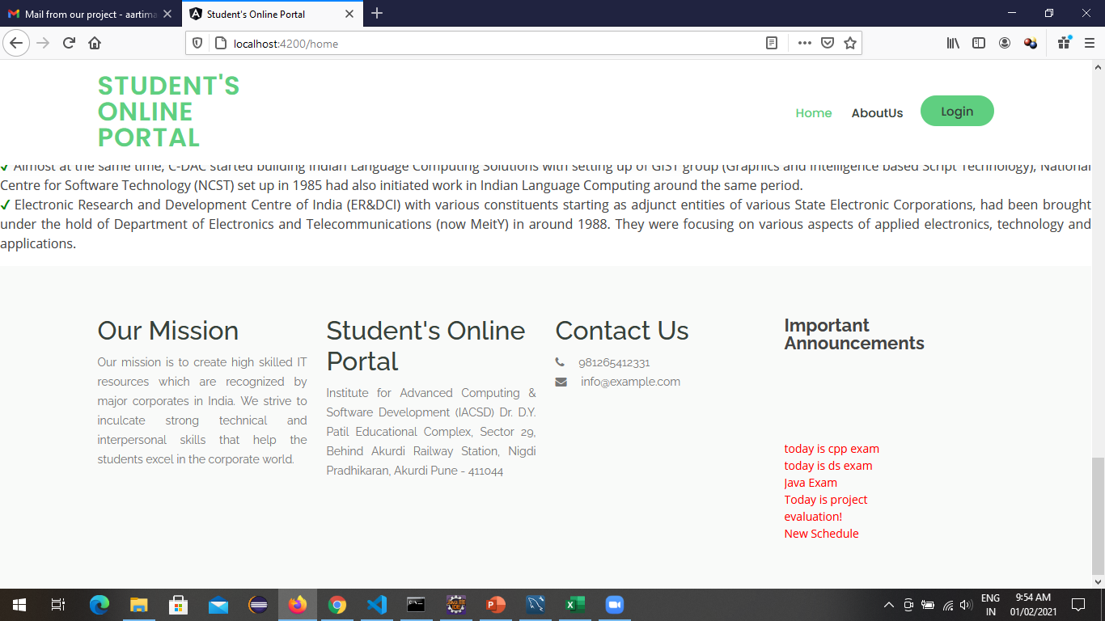
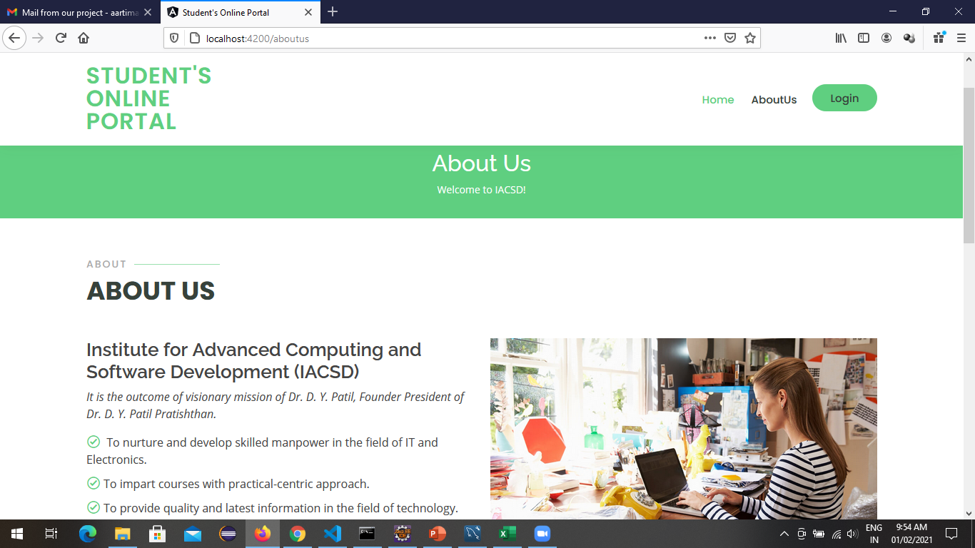

Slide 16
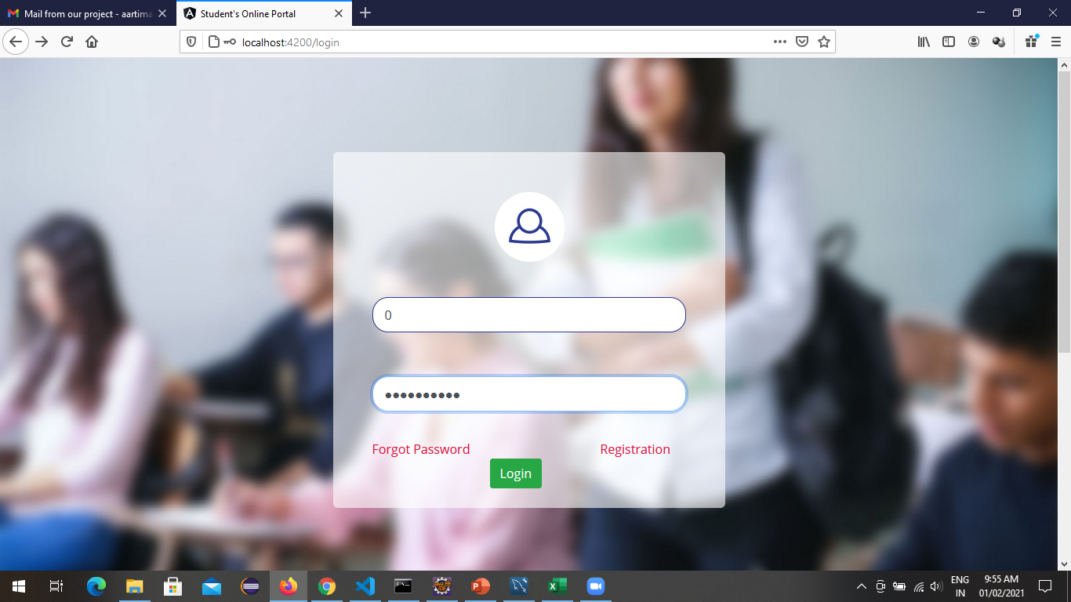
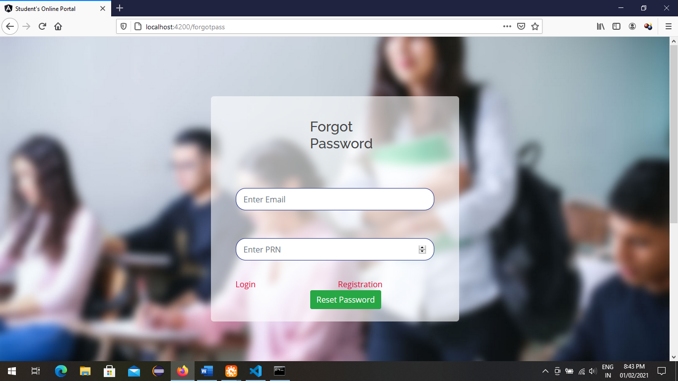
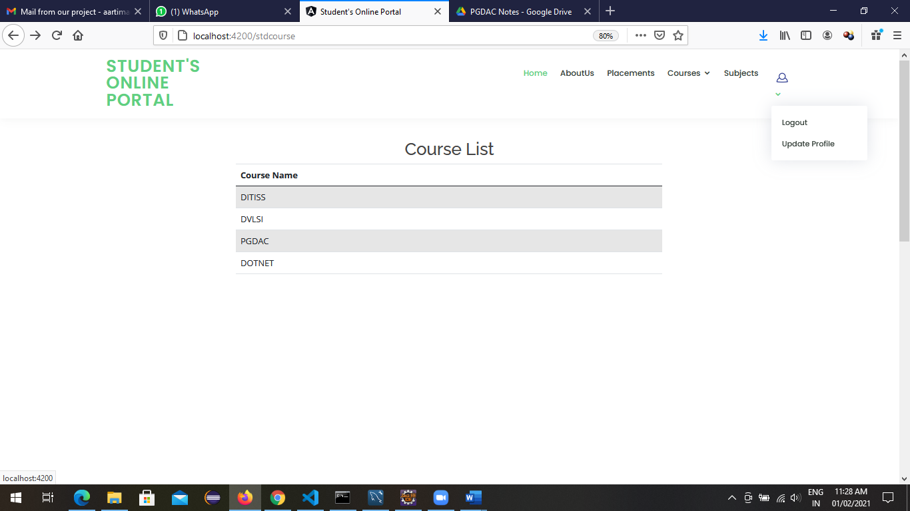
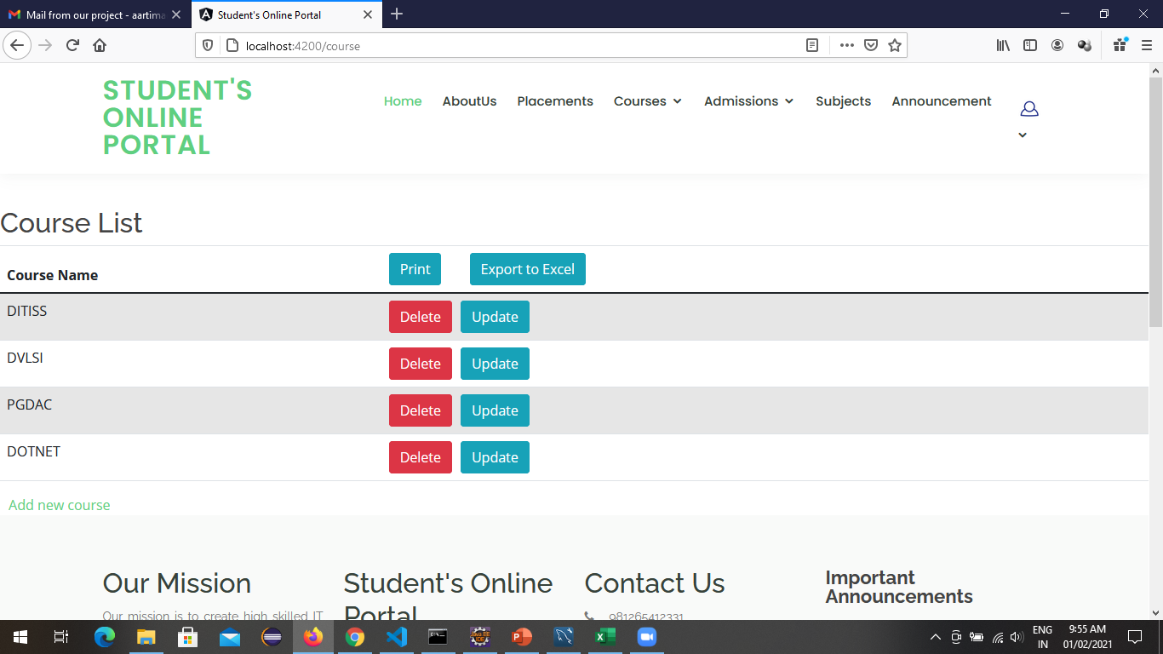

Slide 17
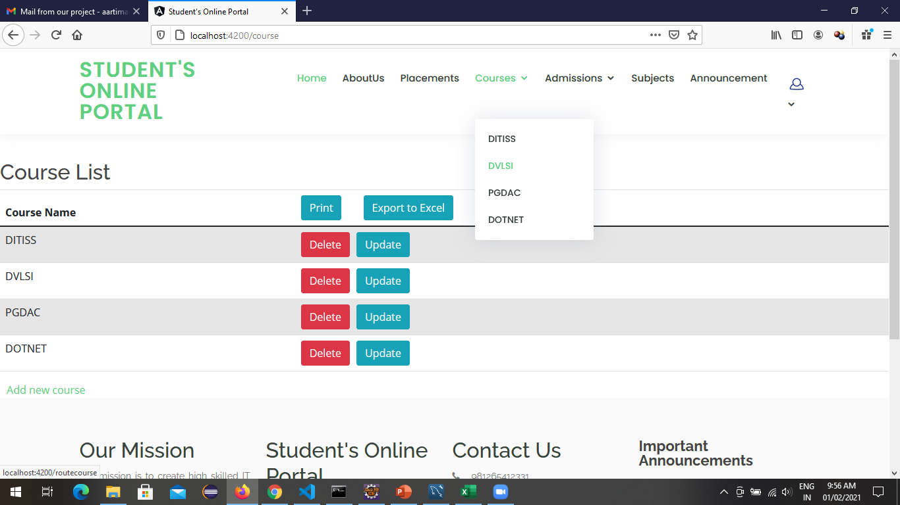
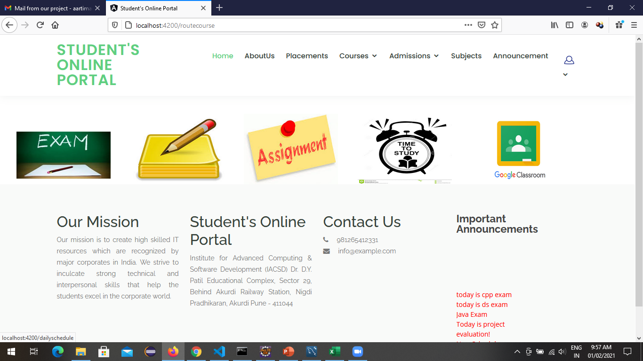
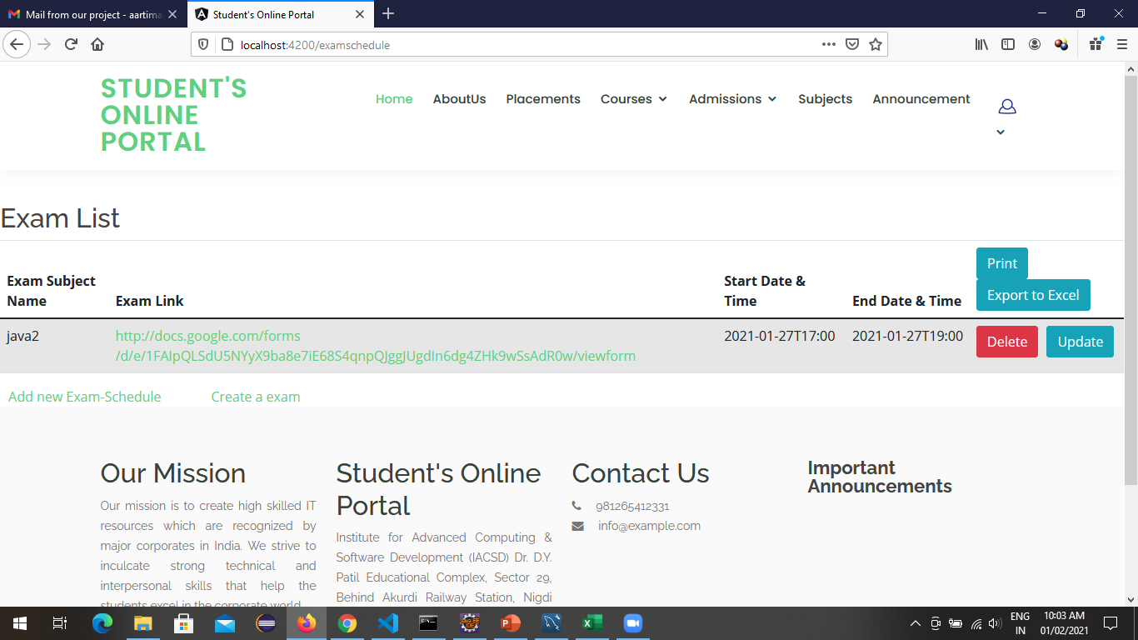
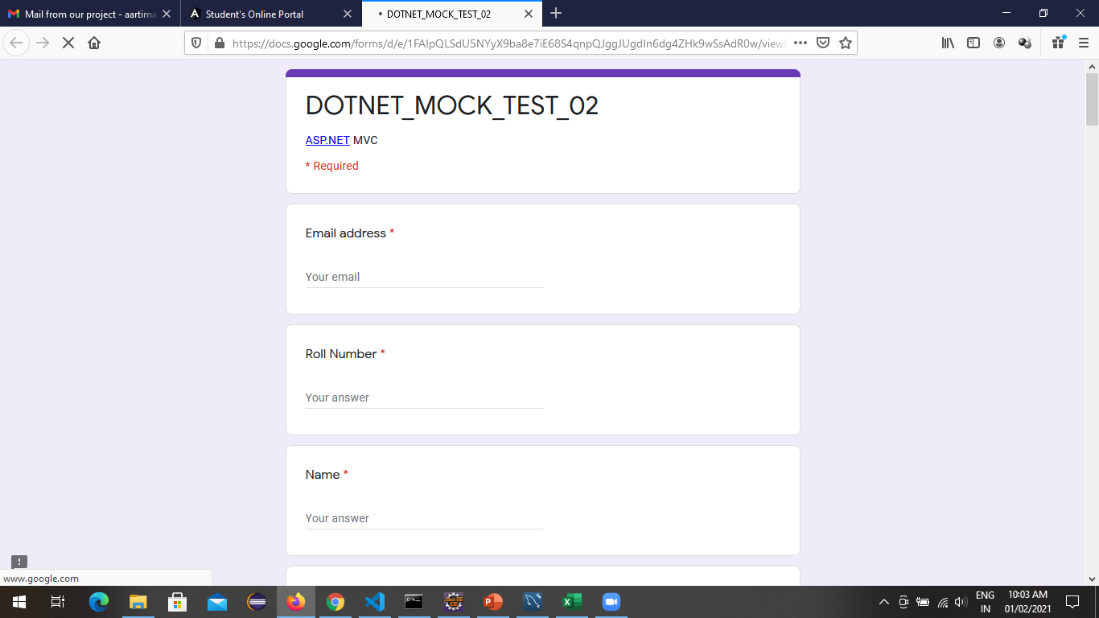

Slide 18
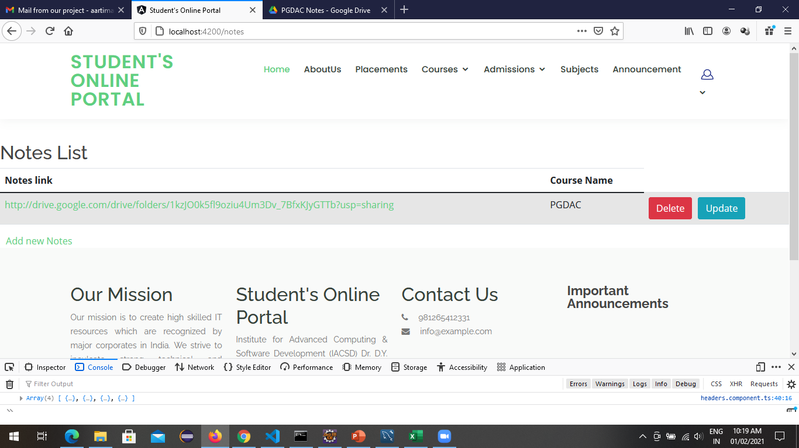
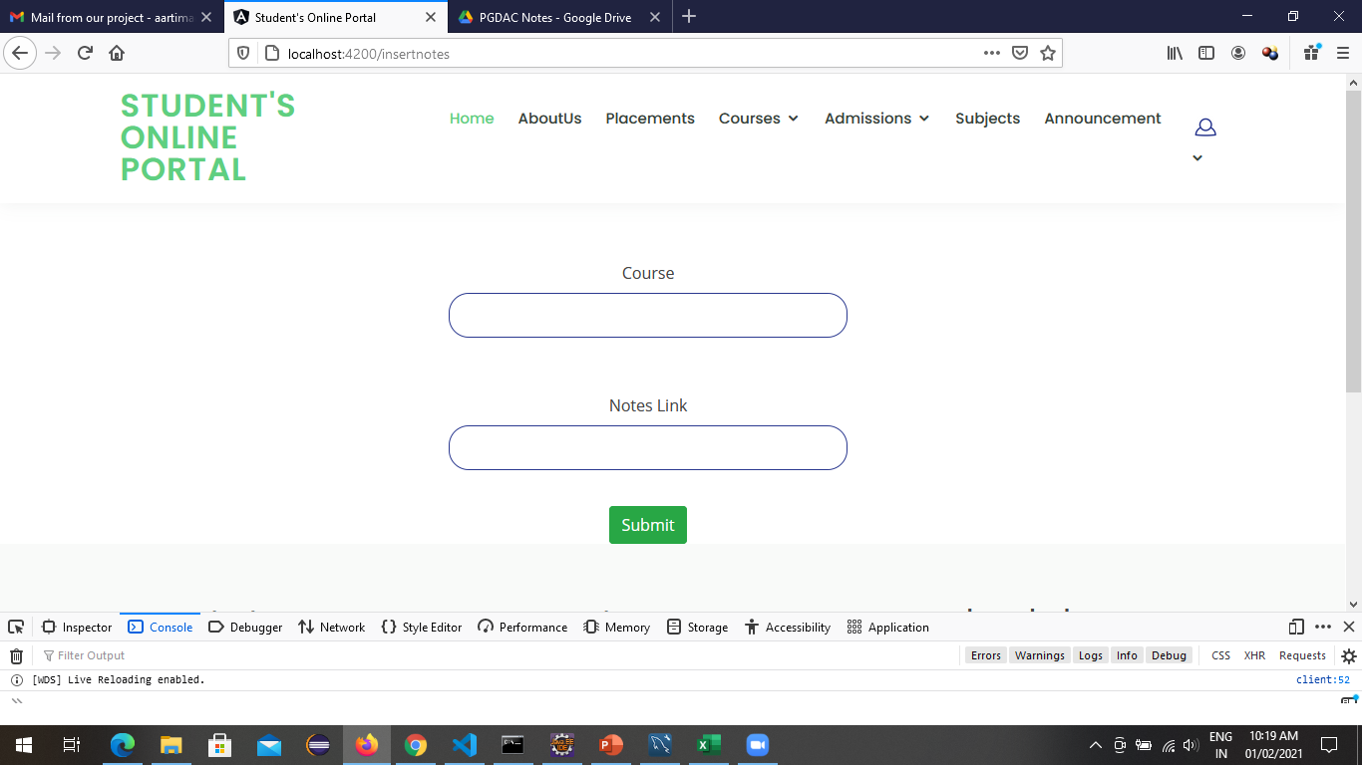
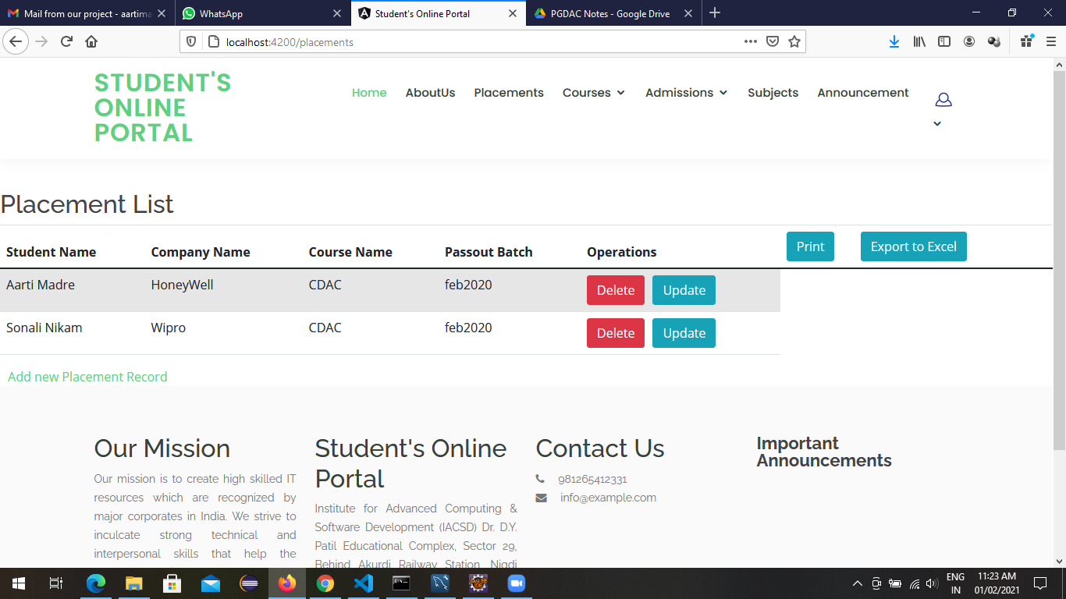
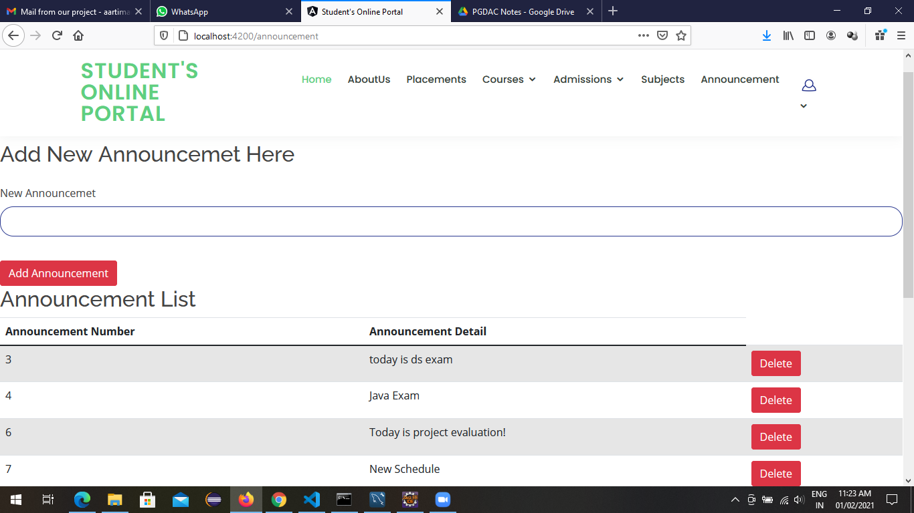

Slide 19
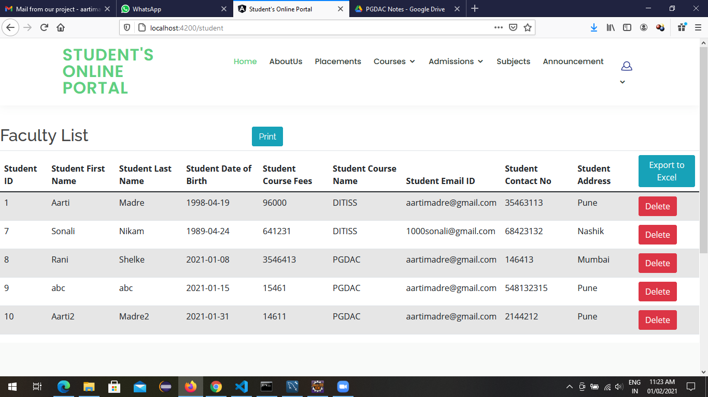
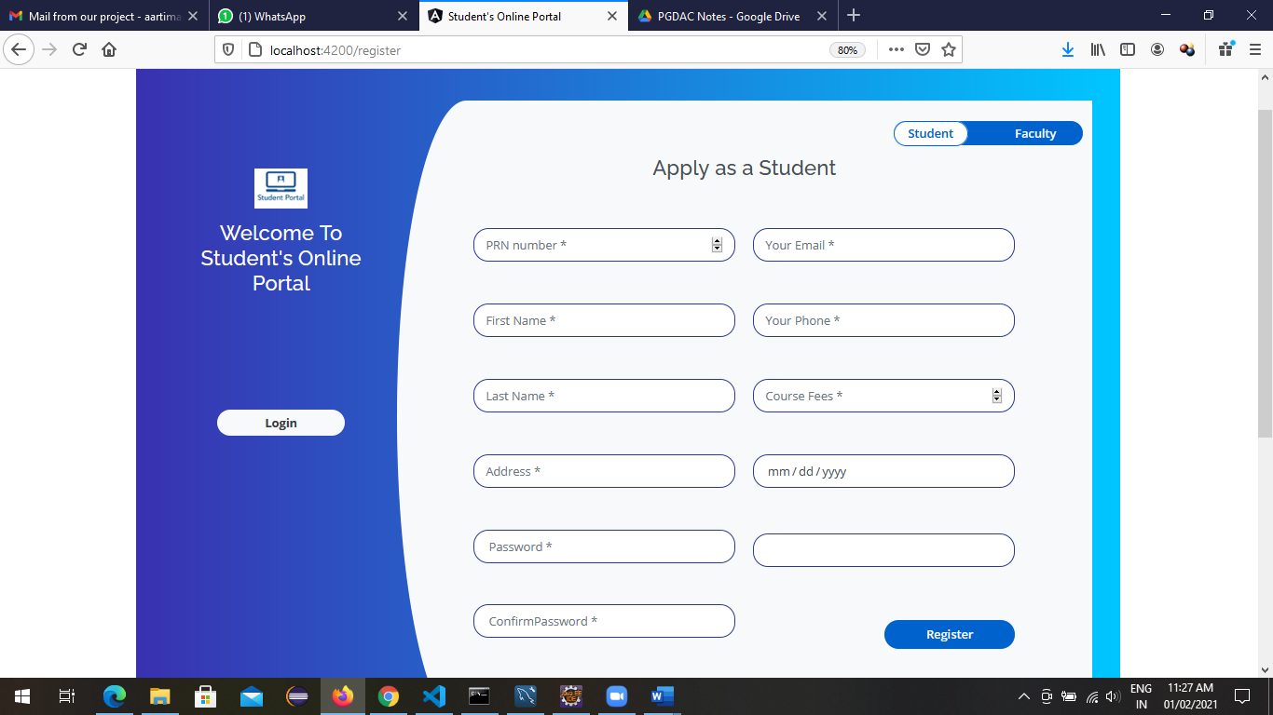
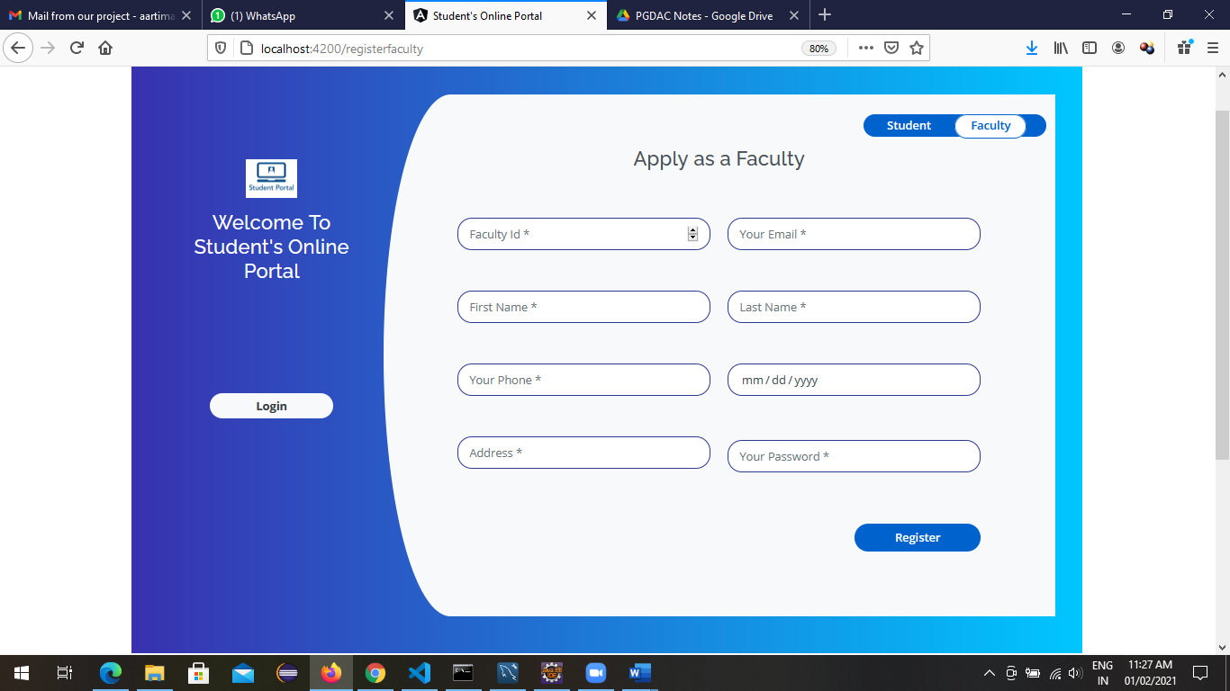

Slide 20
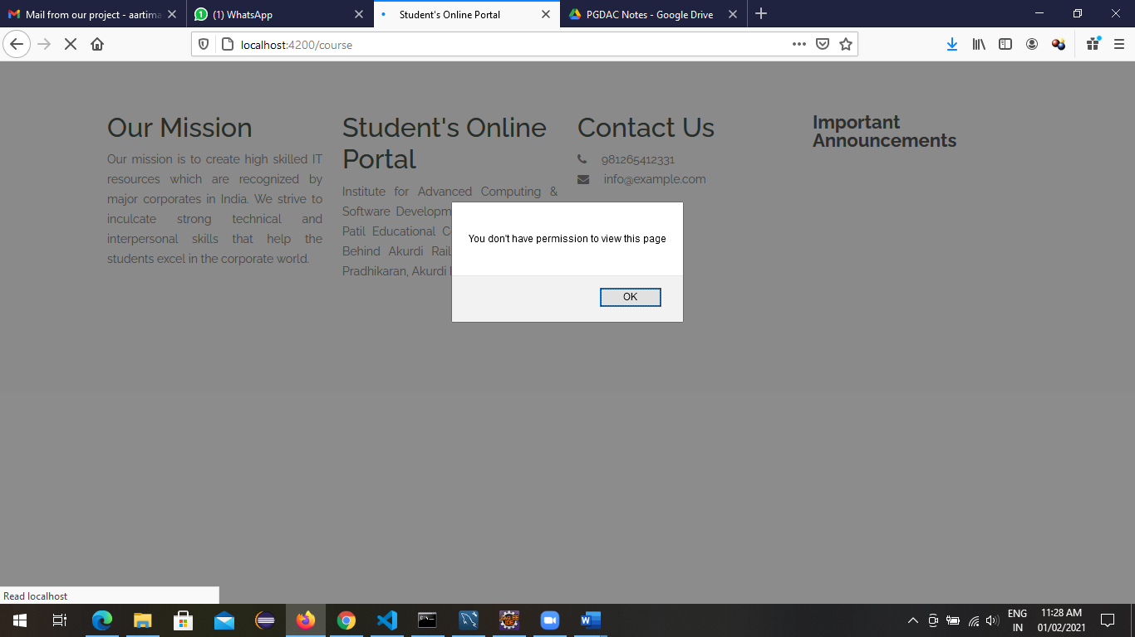
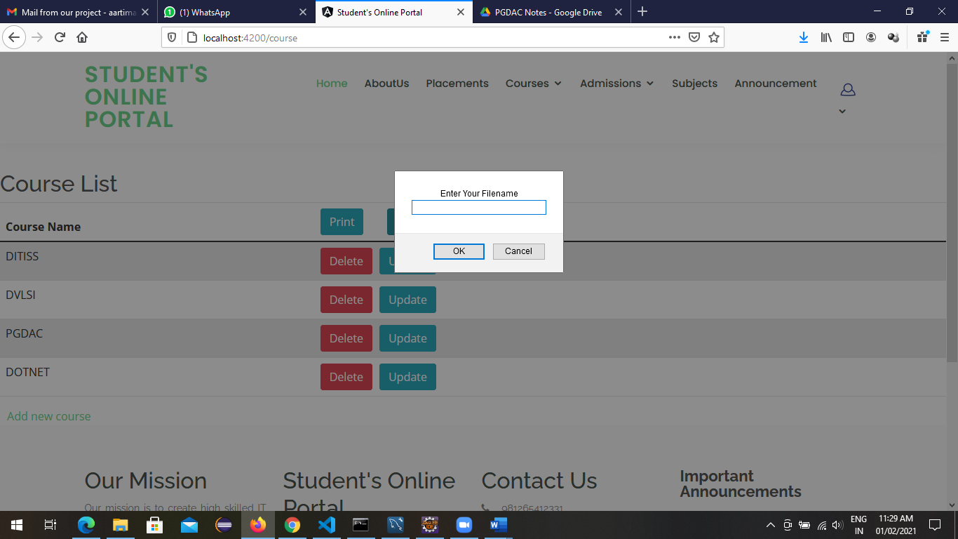
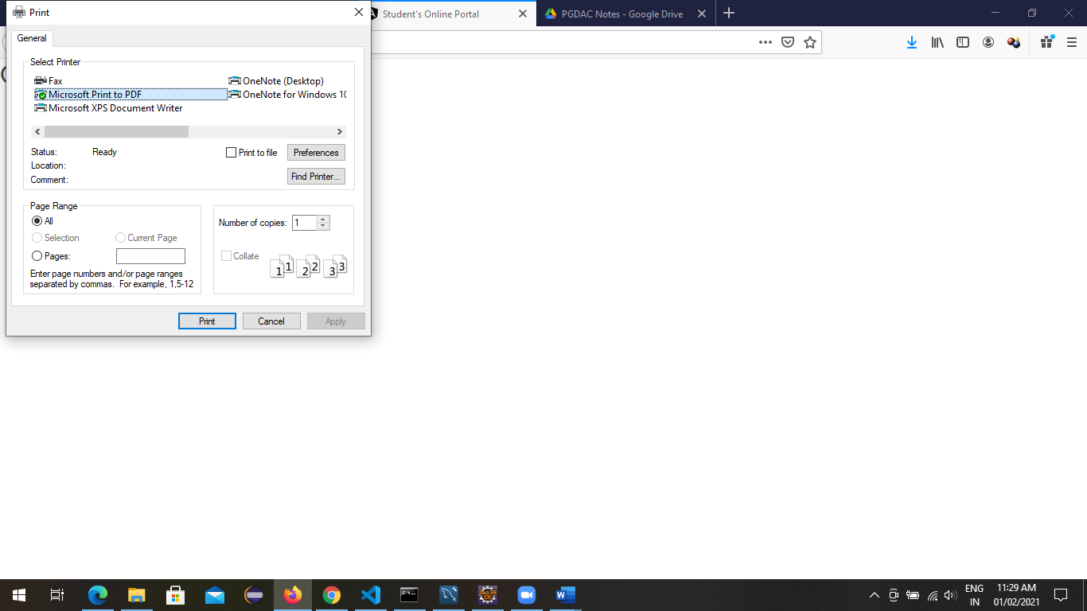
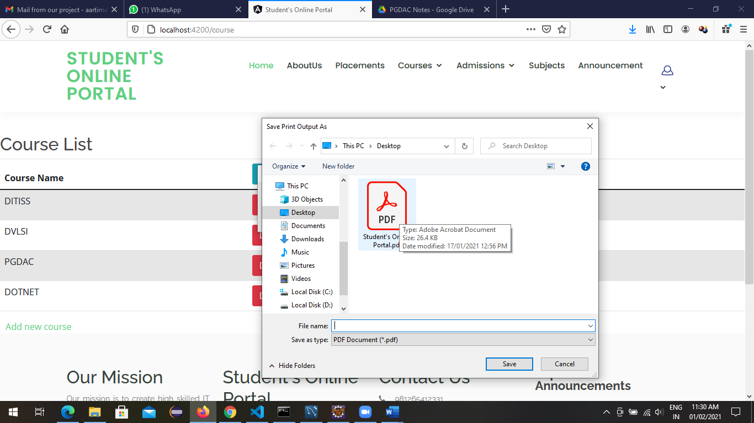

Slide 21
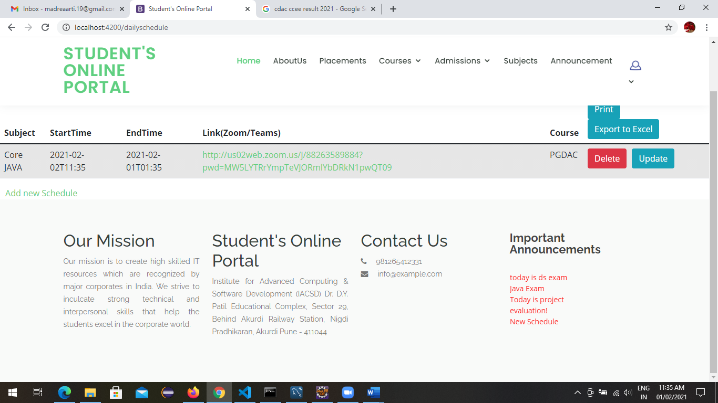
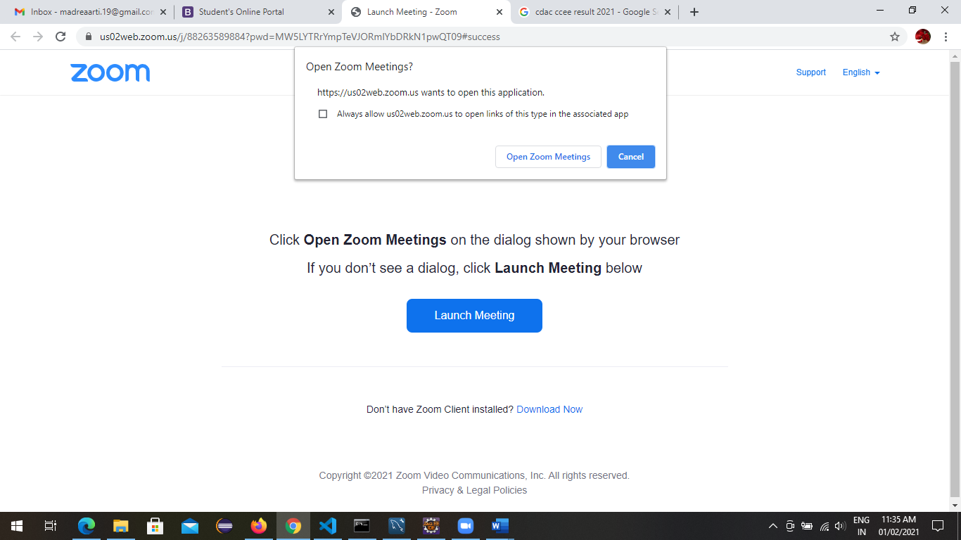
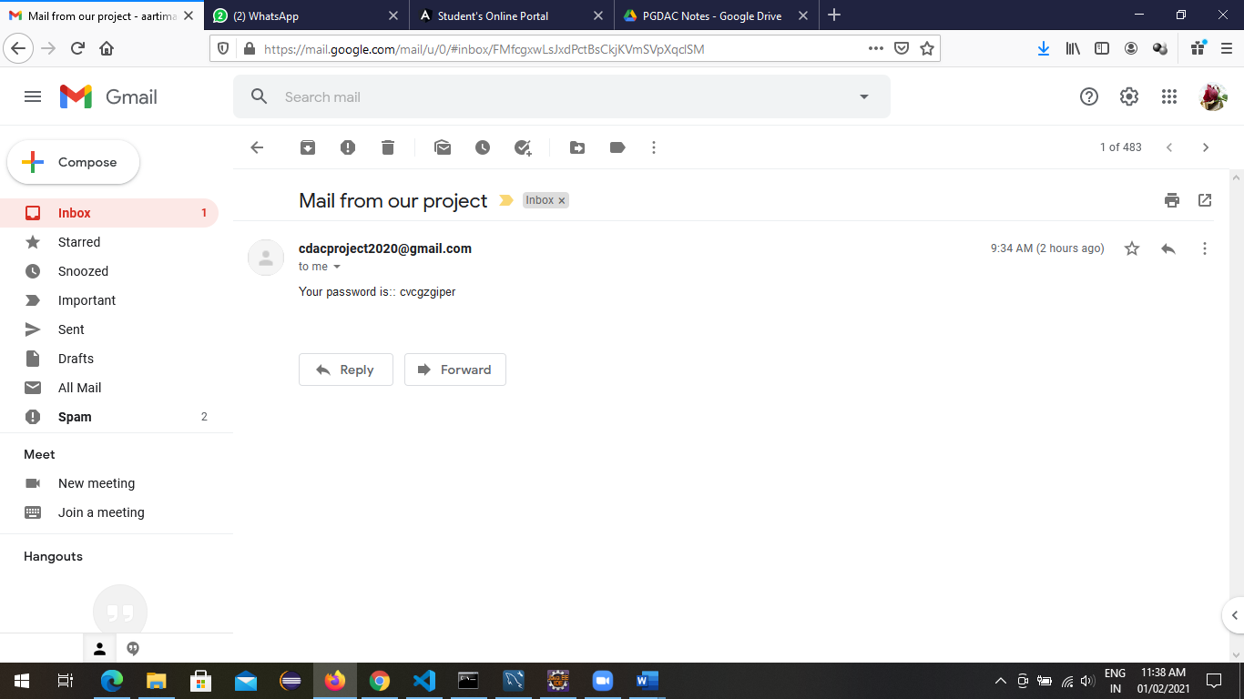
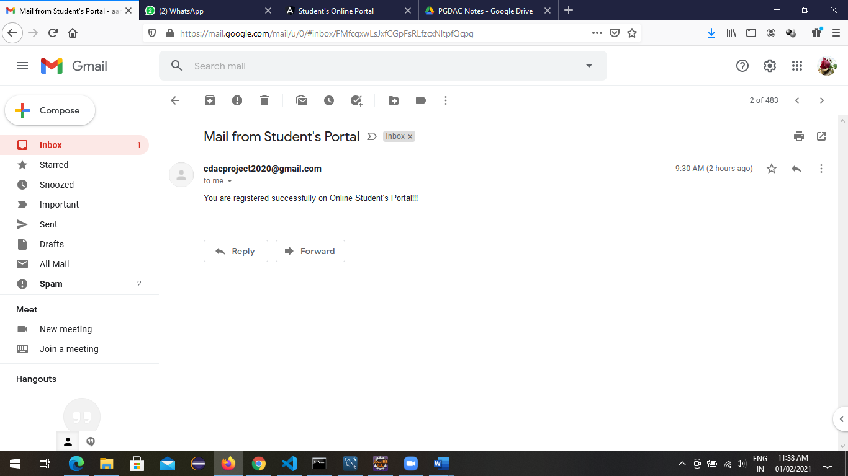

Slide 22
Specification
The application will use JavaScript, jQuery and CSS as main web technologies.
HTTP and FTP protocols are used as communication protocols. FTP is used to upload the web application in live domain and the client can access it via HTTP protocol.
SMTP protocol is used for Email communication.
Several types of validations make this web application a secured one and SQL Injections can also be prevented.
Since Pizza Ordering System is a web-based application, internet connection must be established.
The Pizza Ordering System will be used on PCs and will function via internet or intranet in any web browser.

Slide 23
S/W and H/W Requirements
Server Side:
Processor: Intel® Xeon® processor 3500 series
HDD: Minimum 500GB Disk Space
RAM: Minimum 4GB
OS: Windows 10, Linux 6
Database: MySQL
Client Side (minimum requirement):
Processor: Intel Dual Core
HDD: Minimum 80GB Disk Space
RAM: Minimum 2GB
OS: Windows 7, Linux

Slide 24
Advantages
Ordering Pizza online saves time and effort
Customers can customize their pizza before ordering
Reduces the likelihood of errors that can occur when taking orders over the phone or in person
Reduces wait times for customers and allows pizza restaurants to process more orders in less time
Enhanced Customer Experience

Slide 25
Disadvantages
Delivery Management is not yet been implemented. This project is based on the consideration that the delivery system will be outsourced
Delivery tracking is not been implemented yet, but surely be looked upon on further coming updates

Slide 26
Conclusion
A web-based pizza ordering system can significantly improve the efficiency and convenience of a restaurant's ordering process. By automating the manual system, the restaurant can reduce errors, improve record-keeping, and enhance customer satisfaction. A web-based system allows customers to place orders easily and quickly, while also providing the restaurant with valuable data for decision-making. Overall, a web-based pizza ordering system is an excellent investment for any restaurant looking to streamline its operations and improve customer experience.

Slide 27
Future Enhancement
This project can be enhanced further by adding additional food items, proper delivery management, delivery tracking facility to enhance user and admin experience
The software is flexible enough to be modified and implemented as per future requirements.
We have tried our Best to present this free and user–friendly website to Institutes.

Slide 28
References
http://www.ijcstjournal.org/volume-7/issue-1/IJCST-V7I1P4.pdf
https://bootstrapmade.com/mentor-free-education-bootstrap-theme/
https://www.javatpoint.com/java-mail-api-tutorial
https://www.w3schools.com/
https://angular.io/docs
https://javaee.github.io/javaee-spec/javadocs/

Slide 29
THANK YOU

